Slide 1
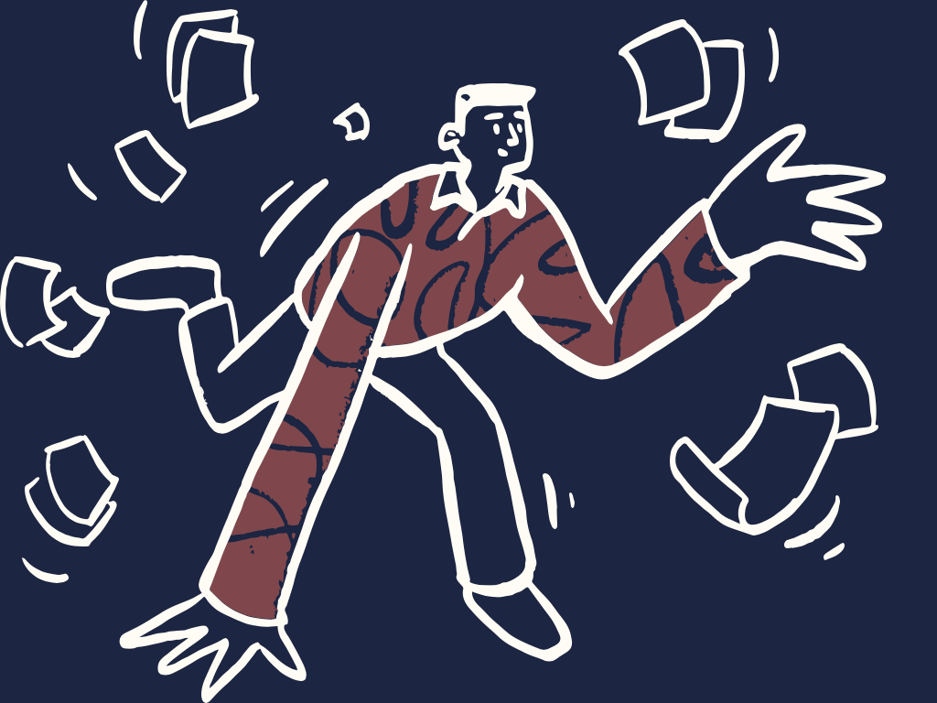
Waste & Reuse
Igor Barakaiev, Disney Vorng,
Miles McCain, and Melissa Weyant
Doodles from OpenDoodles.com

Slide 2
Needfinding methodology

Slide 3
11
interviews

Slide 4
Who?
Dumpster divers
Eco-activists
Waste engineers
College students
Regular people
Notes:
A mix of extreme users, moderate users, and experts

Slide 5
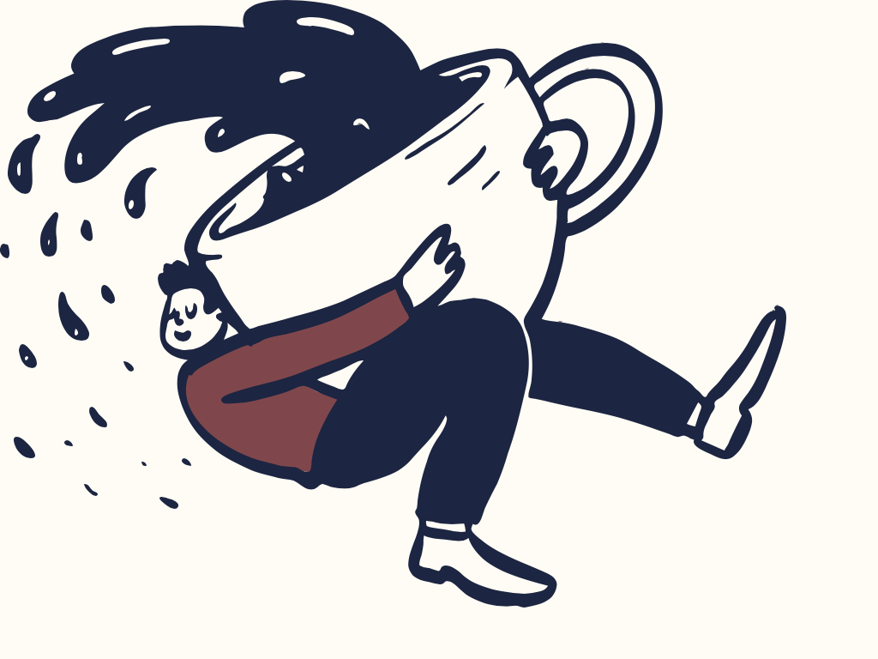
… and even a molecular coffee maker!

Slide 6
How?
Reddit
Twitter
Friends
Notes:
A mix of extreme users, moderate users, and experts. Reddit (/ZeroWaste, /DumpsterDiving)

Slide 7
...and where?

Slide 8
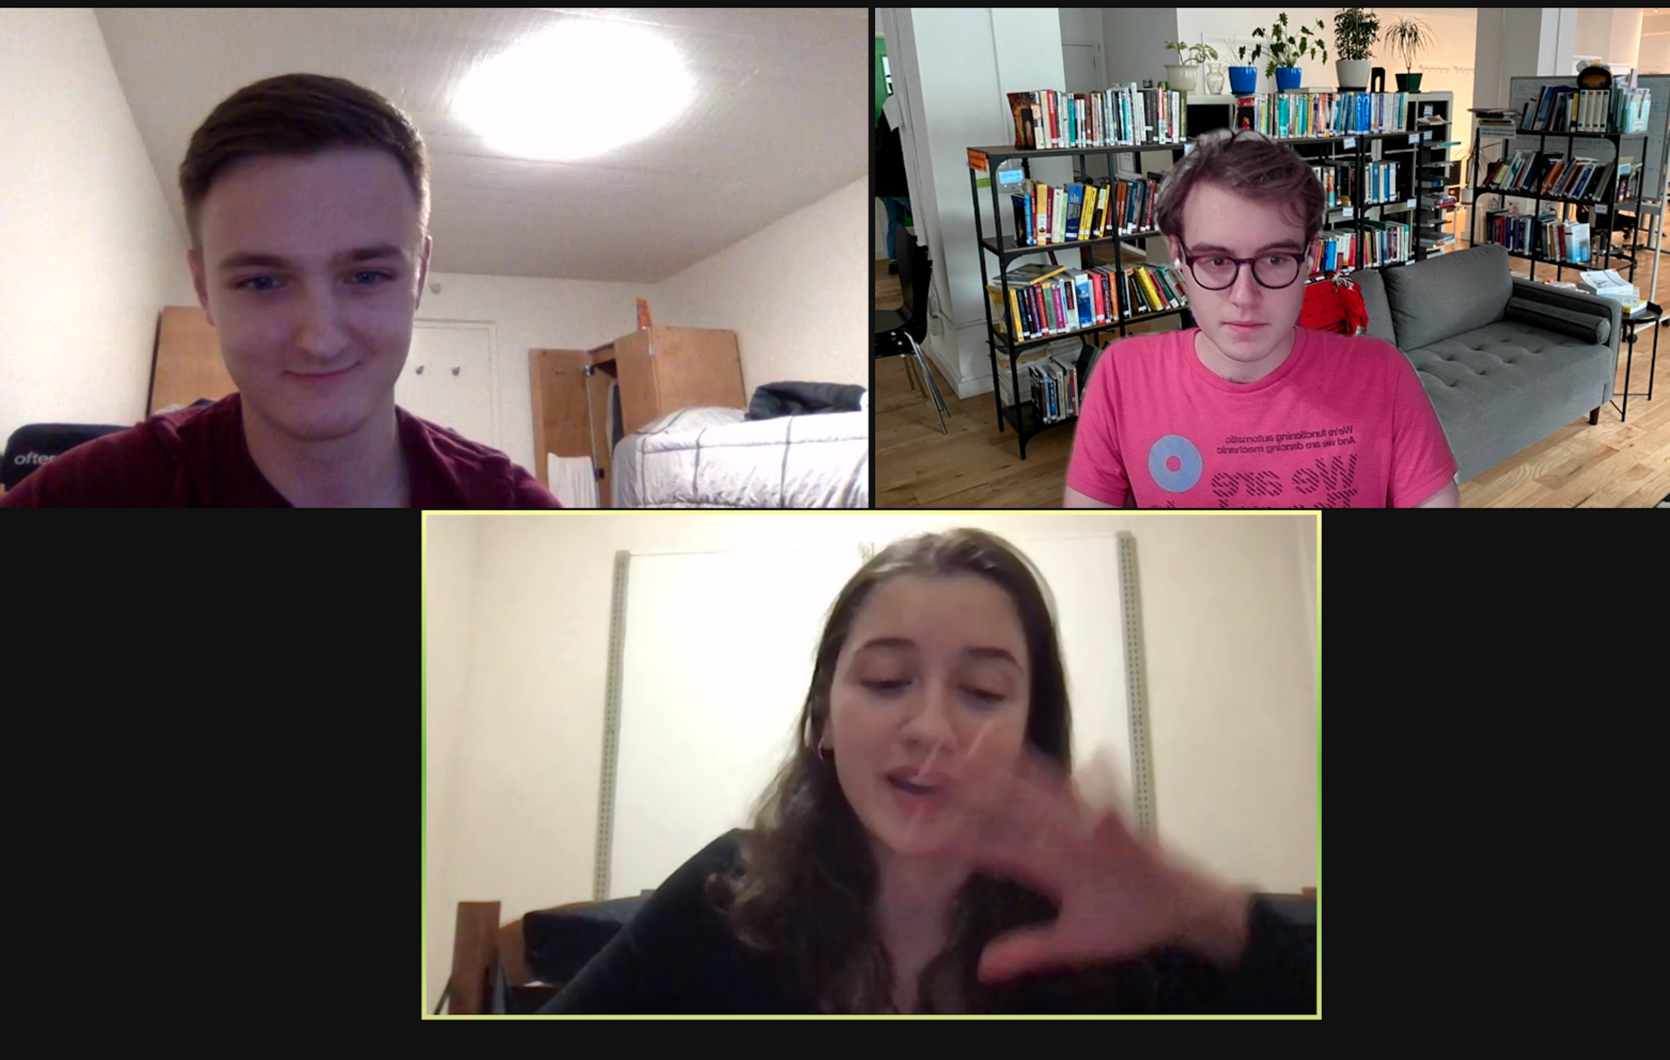
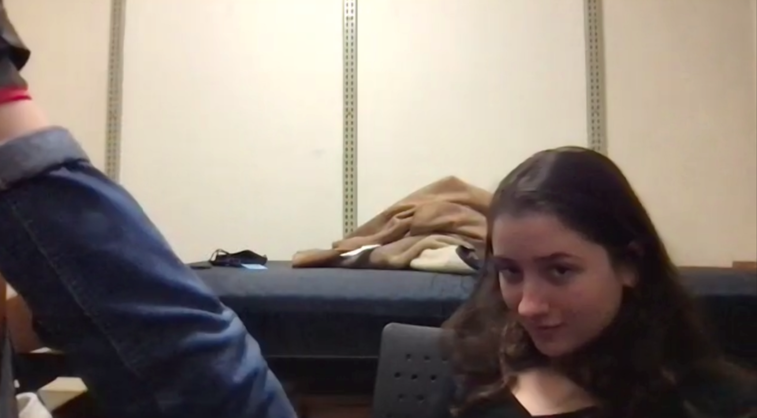
On Zoom...

Slide 9
Q’s
“How has COVID changed things?”
“Tell me about a time you felt wasteful.”
“What disposable products do you use?”
“What was the last thing you bought used?”
“Where do you look to buy things?”
“How do you get rid of valuable items?”
“What motivates you to act sustainably?”
“Where do you see waste in your life?”

Slide 10
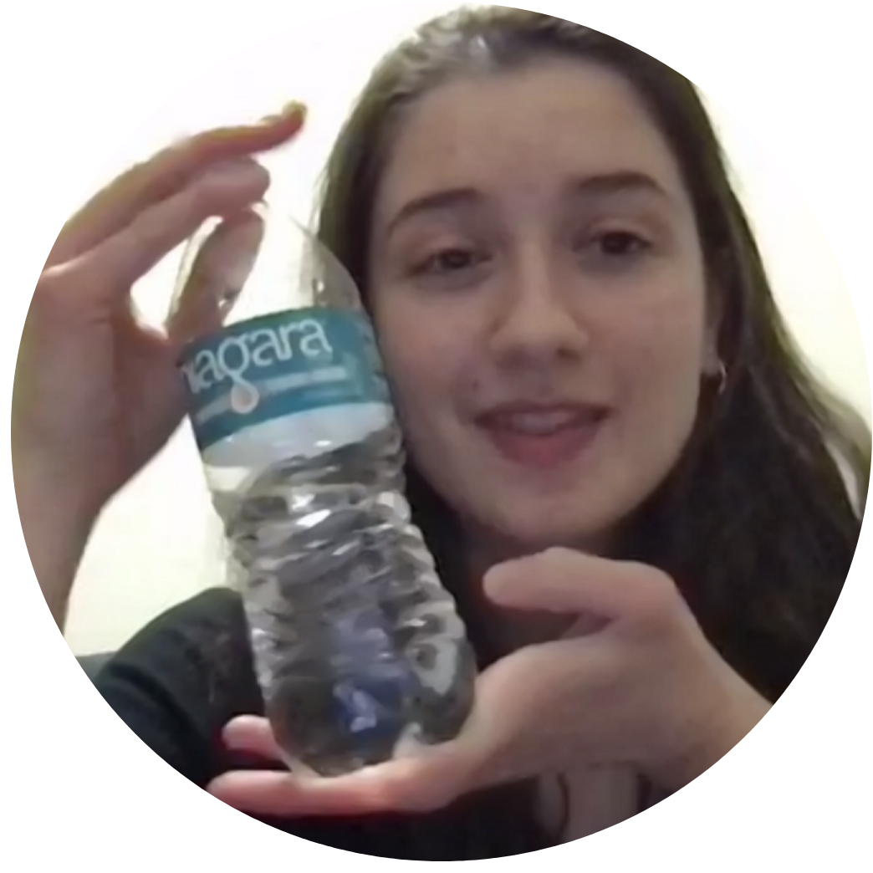
Nadiia
college student
“I feel like sustainability efforts are often not effective and more performative”

Slide 11
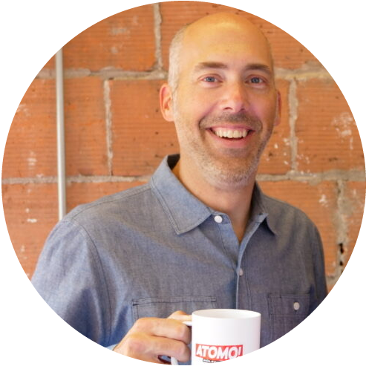
Andy
Atomo cofounder
“We used to ship using styrofoam… that was wasteful and didn’t align with our mission.”
Photo from https://www.geekwire.com/2019/atomo-coffee-ditches-bean-raises-nice-seed-2-6m-funding-develop-molecular-brew. This is not an exact quote from Andy, but it’s the spirit of what he said. Out of respect, we didn’t make an audio recording.

Slide 12

Mimi
wren.co founder
“The biggest levers [of environmental change] are around consumption and your lifestyle.”

Slide 13

Arzy
Teen from Crimea
“Packaging. You can’t avoid it, especially during COVID. Stores prepack everything so you can’t bring your own bag.”

Slide 14

Dan
dumpster diver
“All the stuff I find [in the dumpster] is practically new off the shelf. There’s so much unnecessary waste.”

Slide 15
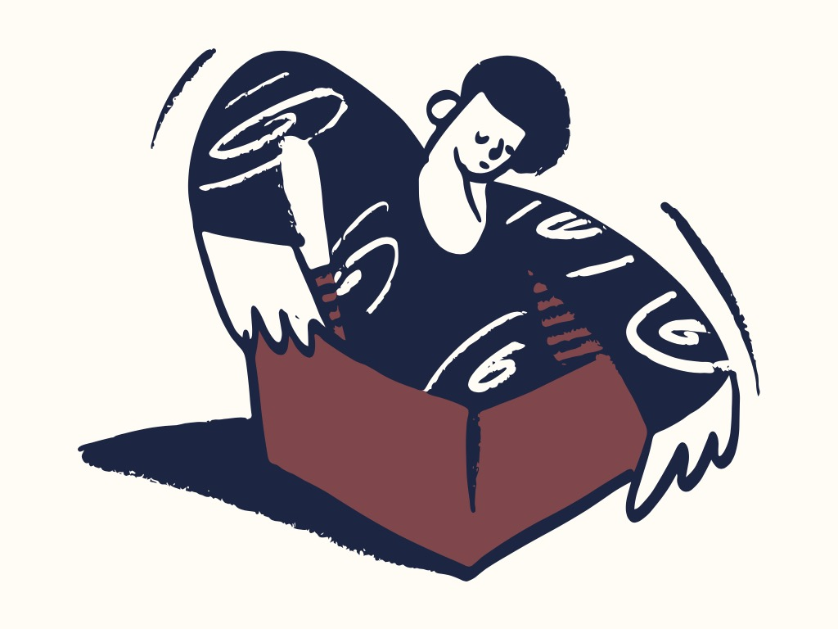
There’s a lot to learn from the dumpster!

Slide 16
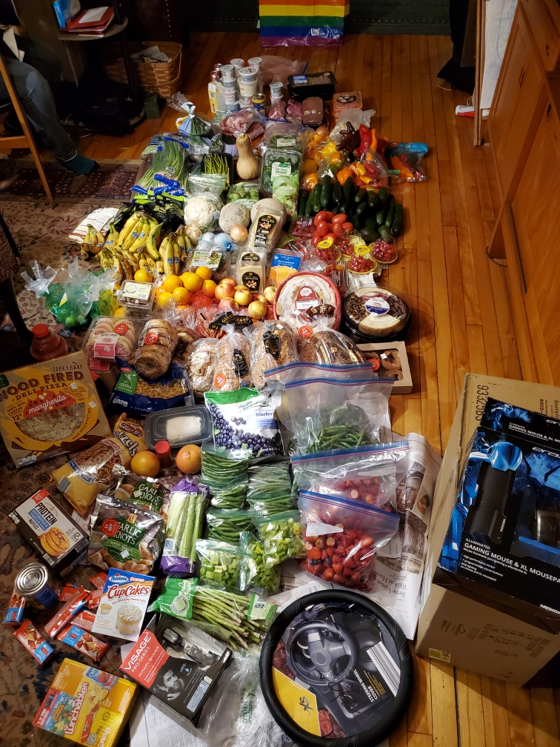
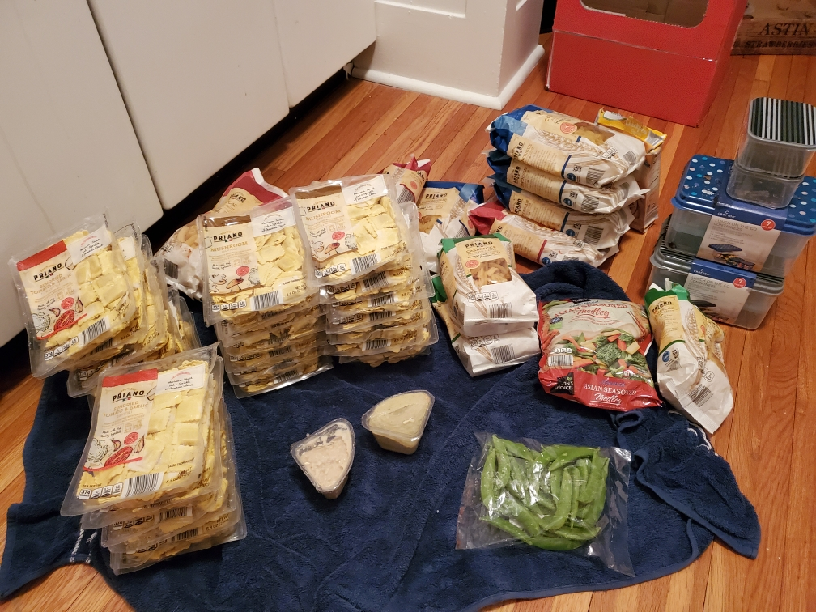
We know you were wondering...

Slide 17
Surprises
Dan sustains himself off dumpster diving.
Kimberly almost exclusively thrifted in college.

Slide 18
Tensions
A dumpster diver buys most of his products new.
An eco-activist uses plastic water bottles.
An eco-startup shipped using styrofoam.

Slide 19
Empathy map

Slide 20
Say
When buying clothes, I prefer to thrift.
I don’t trust people selling online. It’s sketchy. I could get hurt or ripped off.
Sometimes I make my own granola bars to avoid plastic waste.
It’s so hard to find what I need [when thrifting]. It’s always the wrong stuff.
In college, I was trying to buy all my clothes from thrift stores.
There’s a lot of food waste in my dining halls.
I dumpster dive to see how hard I can go.
There is effort involved in donating [stuff].

Slide 21
Do
Sorts through piles of old books to find the right textbooks.
Buys sustainable brands if they are affordable.
Buys clothes exclusively from thrift stores.
Evaluates the quality of the food through sight and smell.
Goes through the trash around move-out day to see what her peers left behind.
Refuses to obtain items that are going to be thrown away.
Reuses things from year to year in college.
Commits a lot of time to find clothes she really needs.

Slide 22
Think
I’m not sustainable for its own sake.
Sustainability can be inconvenient and it’s necessary to consider the costs.
It doesn’t make sense to make my life unnecessarily difficult for a marginal impact.
Great goods can be found in the dumpsters on college campuses during move out periods.
If I can help it, I’ll buy from eco-friendly brands.
I don’t trust myself to thrift or scavenge for items I’m not familiar with.
Dumpster diving is a choice; I could afford groceries.
It’s important to focus on the root of the problem and not on secondary impacts.

Slide 23
Feel
Sustainability is sometimes performative.
Nervous about people judging him for dumpster diving.
Disappointed that her dining hall throws out a lot of food when there are food insecure areas nearby.
Optimistic that people will do more good if it is made more accessible.
Concerned and nervous about carbon emissions from transportation.
Disappointed that people make unintentional or unnecessary purchases.
Disappointed that her friends don’t thrift with her.
Frustrated that many food delivery services use more plastic than necessary.

Slide 24
Initial insights

Slide 25
People consume sustainably when it’s convenient
Make it easier to buy used than it is to buy new
Insight
“I don’t want to be [an environmental] martyr… I’m not going to make my life unnecessarily difficult.”
— Nadiia
Need

Slide 26
Don’t expect consumers to pay more for sustainable goods
Competitive, cost-effective sustainable alternatives
Insight
“I don’t think Atomo! would have succeeded if the price had been higher than the price of normal coffee.”
— Andy
Need

Slide 27
Buyers often can’t find the right reusables locally
Better surfacing and matchmaking for reusables
Insight
“I don’t give up when searching for certain items...I [sometimes] ask to borrow from friends.”
— Arzy
Need

Slide 28
Lots of ‘waste’—food or not—is actually perfectly fine for use
Better visibility into items’ durability and shelf life
Insight
“Most items haven’t reached their expiration date and we as humans can identify what’s good and bad.”
— Dan
Need

Slide 29
Summary
People act sustainably when it benefits them directly.
People are uneasy about buying used, thrifting, and dumpster diving.
When looking for something specific, sourcing locally is hard.

Slide 30
Q’s?

Slide 31
All Participants
Amelia, waste treatment engineer (expert)
Andrew, college student
Andy, Atomo cofounder
Arzy, teen from Crimea
Ash, sustainably-minded Canadian
Dan, dumpster diver and nurse
Kimberly, sustainability coordinator
Melissa, UX designer
Mimi, wren.co cofounder
Nadia, US college student (Ukrainian)
Jessica, high school student
Participants are American unless noted otherwise.

